Slide 1


2021
NET for Apache Spark, ¿Por qué no?
Sergio León
CTO Developer en Analyticalways
@panicoenlaxbox
Alejandro García
SRE Developer en Analyticalways
9-10 Oct 21
@alexmiravet

Slide 3
¿De qué vamos a hablar?
Instalación de Spark en local
PySpark en local y en Databricks
.NET for Apache Spark en local y en Databricks
ASP.NET usando Databricks
ASP.NET usando ODBC de Databricks

Slide 4

Python
https://www.panicoenlaxbox.com/post/install-spark-on-windows/
spark-shell
pyspark

Slide 5
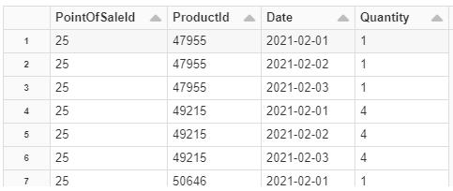
Python
from pyspark.sql import SparkSession
from pyspark.sql import functions as F
spark = SparkSession.builder.getOrCreate()
df = spark.read.parquet(r"C:\Users\azureuser\netcoreconf\daily_stock")
df = (
df.groupBy(F.col("PointOfSaleId"))
.agg(
F.count("*").alias("count"),
F.min(F.col("Date")).alias("min_date"),
F.max(F.col("Date")).alias("max_date"),
)
.orderBy("count", ascending=False)
.withColumnRenamed("PointOfSaleId", "point_of_sale_id")
)
df.show()
from pyspark.sql import SparkSession
spark = SparkSession.builder.getOrCreate()
df = spark.read.parquet(r"C:\Users\azureuser\netcoreconf\daily_stock")
df.createOrReplaceTempView("daily_stock")
spark.sql("""
SELECT
PointOfSaleId AS point_of_sale_id,
COUNT(*) AS count,
MIN(Date) AS min_date,
MAX(Date) AS max_date
FROM
daily_stock
GROUP BY
PointOfSaleId
ORDER BY
count DESC
""").show()

Slide 6
Python
python -m venv env
env\Scripts\activate
pip install pyspark
python main.py
python main2.py

Slide 7
ADLS Gen2
# You can configure your current spark session to allow access to a storage account
storage_account = "stnetcoreconf"
storage_account_access_key = "YOUR_STORAGE_ACCESS_KEY"
spark.conf.set(f"fs.azure.account.key.{storage_account}.dfs.core.windows.net", storage_account_access_key)
container = "netcoreconf"
directory = "daily_stock"
df = spark.read.parquet(f"abfss://{container}@{storage_account}.dfs.core.windows.net/{directory}")
display(df)
# When you mount object storage, every cluster in the Databricks workspace will have access and it will persist between cluster reboots
service_principal_application_id = "YOUR_APPLICATION_ID"
service_principal_tenant_id = "YOUR_TENANT_ID"
service_principal_secret = "YOUR_SECRET"
# Service principal needs storage blob data contributor role
extra_configs = {
"fs.azure.account.auth.type": "OAuth",
"fs.azure.account.oauth.provider.type": "org.apache.hadoop.fs.azurebfs.oauth2.ClientCredsTokenProvider",
"fs.azure.account.oauth2.client.id": service_principal_application_id,
"fs.azure.account.oauth2.client.secret": service_principal_secret,
"fs.azure.account.oauth2.client.endpoint": f"https://login.microsoftonline.com/{service_principal_tenant_id}/oauth2/token",
"fs.azure.createRemoteFileSystemDuringInitialization": "true“ }
storage_account = "stnetcoreconf"
container = "netcoreconf"
source = f"abfss://{container}@{storage_account}.dfs.core.windows.net/"
mount_point = "/mnt/netcoreconf" # mnt/ by convention
dbutils.fs.mount(source=source, mount_point=mount_point, extra_configs=extra_configs)
display(spark.read.parquet("/mnt/netcoreconf/daily_stock"))

Slide 8
ADLS Gen2
%sql CREATE DATABASE IF NOT EXISTS netcoreconf;
%sql USE netcoreconf;
%sql CREATE TABLE IF NOT EXISTS daily_stock
USING PARQUET
LOCATION 'dbfs:/mnt/netcoreconf/daily_stock';
%sql SELECT * FROM daily_stock;
from pyspark.sql import functions as F
df = spark.read.parquet("/mnt/netcoreconf/daily_stock")
df = (
df.groupBy(F.col("PointOfSaleId"))
.agg(F.count("*").alias("count"), F.min(F.col("Date")).alias("min_date"), F.max(F.col("Date")).alias("max_date"))
.orderBy("count", ascending=False)
.withColumnRenamed("PointOfSaleId", "point_of_sale_id"))
df.show()
spark.sql("""SELECT
PointOfSaleId AS point_of_sale_id,
COUNT(*) AS count,
MIN(Date) AS min_date,
MAX(Date) AS max_date
FROM
netcoreconf.daily_stock
GROUP BY
PointOfSaleId
ORDER BY
count DESC""").show()

Slide 9
.NET for Apache Spark
.NET Core 3.1
https://github.com/dotnet/spark/releases/download/v2.0.0/Microsoft.Spark.Worker.net461.win-x64-2.0.0.zip
DOTNET_WORKER_DIR
C:\Microsoft.Spark.Worker-2.0.0

Slide 10
.NET for Apache Spark
dotnet new console --output ConsoleApp1 --framework netcoreapp3.1
cd ConsoleApp1
dotnet add package Microsoft.Spark
using Microsoft.Spark.Sql;
using F = Microsoft.Spark.Sql.Functions;
namespace ConsoleApp1
{
class Program
{
static void Main(string[] args)
{
var spark = SparkSession.Builder().GetOrCreate();
var df = spark.Read().Parquet(args[0]);
df = df.GroupBy((F.Col("PointOfSaleId")))
.Agg(
F.Count("*").Alias("count"),
F.Min(F.Col("Date")).Alias("min_date"),
F.Max(F.Col("Date")).Alias("max_date"))
.OrderBy(F.Col("count").Desc())
.WithColumnRenamed("PointOfSaleId", "point_of_sale_id");
df.Show();
}
}
}
dotnet build
spark-submit --class org.apache.spark.deploy.dotnet.DotnetRunner bin\Debug\netcoreapp3.1\microsoft-spark-3-1_2.12-2.0.0.jar dotnet bin\Debug\netcoreapp3.1\ConsoleApp1.dll "C:\Users\azureuser\netcoreconf\daily_stock"

Slide 11
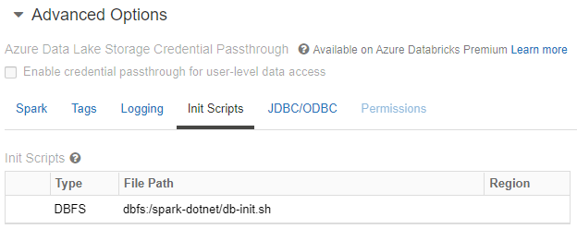

Databricks
pip install databricks-cli
databricks configure --token
cat C:\Users\azureuser\.databrickscfg
databricks fs cp databricks\db-init.sh dbfs:/spark-dotnet/db-init.sh
# DOTNET_SPARK_RELEASE=https://github.com/dotnet/spark/releases/download/v2.0.0/Microsoft.Spark.Worker.netcoreapp3.1.linux-x64-2.0.0.tar.gz
databricks fs cp databricks\install-workers.sh dbfs:/spark-dotnet/install-worker.sh
> dotnet publish --configuration Release --framework netcoreapp3.1 --runtime ubuntu.16.04-x64
> Compress-Archive -Path .\bin\Release\netcoreapp3.1\ubuntu.16.04-x64\publish\* -DestinationPath .\databricks\publish.zip -Force
> databricks fs cp --overwrite .\databricks\publish.zip dbfs:/spark-dotnet/publish.zip
> databricks fs cp --overwrite bin\Release\netcoreapp3.1\ubuntu.16.04-x64\microsoft-spark-3-1_2.12-2.0.0.jar dbfs:/spark-dotnet/microsoft-spark-3-1_2.12-2.0.0.jar

Slide 12
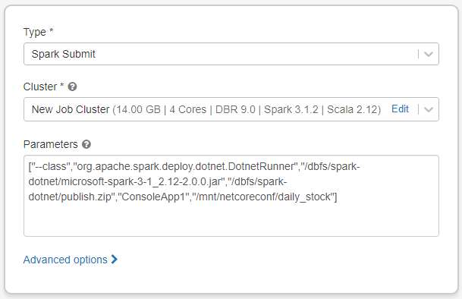
Databricks – Spark Submit
https://docs.microsoft.com/en-us/dotnet/spark/how-to-guides/databricks-deploy-methods#deploy-using-spark-submit
["--class","org.apache.spark.deploy.dotnet.DotnetRunner","/dbfs/spark-dotnet/microsoft-spark-3-1_2.12-2.0.0.jar","/dbfs/spark-dotnet/publish.zip","ConsoleApp1","/mnt/netcoreconf/daily_stock"]

Slide 13
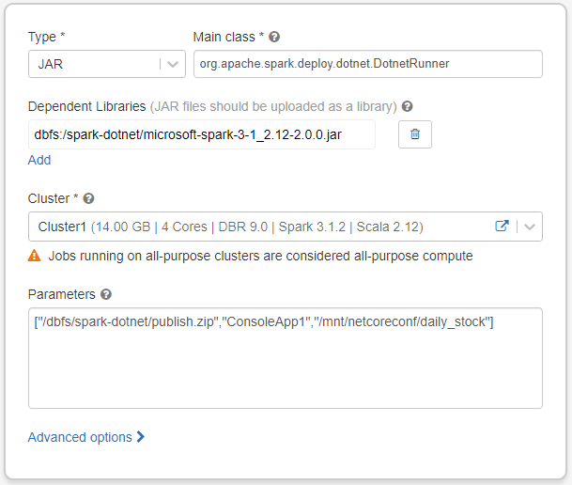
Databricks – JAR
https://docs.microsoft.com/en-us/dotnet/spark/how-to-guides/databricks-deploy-methods#deploy-using-set-jar
["/dbfs/spark-dotnet/publish.zip","ConsoleApp1","/mnt/netcoreconf/daily_stock"]

Slide 14
Databricks Connect
https://docs.microsoft.com/es-es/azure/databricks/dev-tools/databricks-connect
8.1 (includes Apache Spark 3.1.1, Scala 2.12)
mkdir databricks-connect
cd databricks-connect
python -m venv env
env\Scripts\activate
pip install databricks-connect
databricks-connect configure
cat C:\Users\azureuser\.databricks-connect
set SPARK_HOME=
set PYSPARK_PYTHON=python
databricks-connect test

Slide 15
Databricks Connect
# ...
df = spark.read.parquet("dbfs:/mnt/netcoreconf/daily_stock")
# ...
python main.py
spark-submit --class org.apache.spark.deploy.dotnet.DotnetRunner ..\ConsoleApp1\bin\Debug\netcoreapp3.1\microsoft-spark-3-1_2.12-2.0.0.jar dotnet ..\ConsoleApp1\bin\Debug\netcoreapp3.1\ConsoleApp1.dll "/mnt/netcoreconf/daily_stock"

Slide 16
Databricks Connect + ASP.NET Core
[HttpGet]
public IEnumerable<DailyStock> Get()
{
var spark = SparkSession.Builder().GetOrCreate();
var df = spark.Read().Parquet("/mnt/netcoreconf/daily_stock");
df = df.GroupBy((F.Col("PointOfSaleId")))
.Agg(
F.Count("*").Alias("count"),
F.Min(F.Col("Date")).Alias("min_date"),
F.Max(F.Col("Date")).Alias("max_date"))
.OrderBy(F.Col("count").Desc())
.WithColumnRenamed("PointOfSaleId", "point_of_sale_id");
var rows = df.Collect();
var result = new List<DailyStock>();
foreach (var row in rows)
{
result.Add(new DailyStock()
{
PointOfSaleId = row.GetAs<int>("point_of_sale_id"),
Count = row.GetAs<int>("count"),
});
}
return result;
}
spark-submit --class org.apache.spark.deploy.dotnet.DotnetRunner WebApplication1\bin\Debug\netcoreapp3.1\microsoft-spark-3-1_2.12-2.0.0.jar dotnet WebApplication1\bin\Debug\netcoreapp3.1\WebApplication1.dll

Slide 17
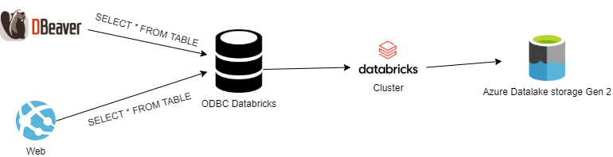
ODBC

Slide 18
ODBC
https://docs.databricks.com/integrations/bi/jdbc-odbc-bi.html
https://databricks.com/spark/odbc-drivers-download

Slide 20
More information:
info@netcoreconf.com
@Netcoreconf
Visit on:
netcoreconf.com
Thank´s

